Slide 1
Highlights of Invest 2035: Industrial Strategy Green Paper
8 “High-Growth” Sectors
6 policy areas
10-year industrial strategy to focus on eight sectors which offer the highest growth opportunity:
Advanced manufacturing
Clean energy industries
Creative industries
Defence
Digital and technologies
Financial services
Life sciences
Professional and business services
Industrial strategy to introduce sector-specific and cross-cutting policies focussed on:
People and skills
Innovation
Energy and infrastructure
The regulatory environment
Crowding in investment
International partnerships and trade
3 types of priority places
Informed by Industrial Strategy Council
Industrial strategy to concentrate efforts on places with the greatest potential for our growth sectors:
city regions,
high-potential clusters, and
strategic industrial sites.
Govt. committed to devolution to mayoral combined authorities, giving them the tools they need to grow sectoral clusters and improve the local business environment through ambitious local growth plans.
A statutory, permanent, and independent Industrial Strategy Council will be established.
The ISC will:
Monitor progress on sectors’ growth and policy implementation
Undertake analysis to improve the evidence base
Feed into policy development through public reports, ministerial commissions, and private discussion papers
Notes:
Note that the Government has published its Industrial Strategy Green Paper.
It outlines the eight “high-growth” sectors – between 1997 and 2022 these sectors have contributed roughly 60% of all productivity growth.
In the next stage of strategy development, the Government will be prioritising subsectors within these broad sectors that meet the IS objectives and where there is evidence that policy can address barriers to growth. ]
Aim is to publish IS and Sector Plans alongside the multi-year Spending Review in Spring 2025.
POLL – eight high growth sectors

Slide 2
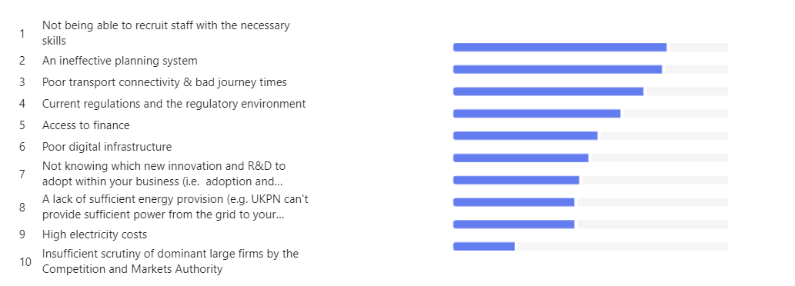
Key questions for KMEP to consider
What are the most significant barriers to investment?
Please could you enter your thoughts on the Microsoft Form – See link in chat
Notes:
Publish poll at the end of this slide.
We have been tasked with completing a consultation response by 24th November. The consultation contains 32 questions – many focussing on specific issues such as data collection and source. But there are some strategic questions that we would like Board members to advise on.

Slide 3
Key questions for KMEP to consider
What people and skills policy solutions are needed to unlock investment?
Government Current Thinking
Growth & Skills Levy - £40m - Commitment to launch shorter and foundation apprenticeships in key sectors
Skills Bootcamps - short courses tailored to industry needs
Skills England – established to addressed skills challenges
Recruitment of 6,500 new teachers
Better early years provision – to help parents back into workplace
Notes:
The Office for Budget Responsibility (OBR) estimates that improving health outcomes among the working-age population, by reducing incidence of work-limiting ill-health by a quarter, would increase the size of the economy by 0.8% over the longer-term.
Around a third of average annual UK productivity growth was attributable to an expansion of skills available in the workforce between 2001 and 2019.
8) Where you identified barriers in response to question 7 which relate to people and skills (including issues such as delivery of employment support, careers, and skills provision), what UK government policy solutions could best address these?
9) What more could be done to achieve a step change in employer investment in training in the growth-driving sectors?

Slide 4
Key questions for KMEP to consider
What people and skills policy solutions are needed to unlock investment?
Government Current Thinking
Growth & Skills Levy - £40m - Commitment to launch shorter and foundation apprenticeships in key sectors
Skills Bootcamps - short courses tailored to industry needs
Skills England – established to addressed skills challenges
Recruitment of 6,500 new teachers
Better early years provision – to help parents back into workplace
Other stakeholder feedback
Need to improve the careers education and inspire the next generation – The issue of work experience continues to dominate conversation. Young people are not familiar with the possibilities out there.
We need to incentivise people to work to increase size of labour market for employers – 1 in 4 people in Kent & Medway are economically inactive due to ill-health (in early 2024), compared to 1 in 5 (in 2020).
More collaboration of Further Education Colleges and Universities (Employment Task Force)
Notes:
The Office for Budget Responsibility (OBR) estimates that improving health outcomes among the working-age population, by reducing incidence of work-limiting ill-health by a quarter, would increase the size of the economy by 0.8% over the longer-term.
Around a third of average annual UK productivity growth was attributable to an expansion of skills available in the workforce between 2001 and 2019.
8) Where you identified barriers in response to question 7 which relate to people and skills (including issues such as delivery of employment support, careers, and skills provision), what UK government policy solutions could best address these?
9) What more could be done to achieve a step change in employer investment in training in the growth-driving sectors?

Slide 5
Key questions for KMEP to consider
What people and skills policy solutions are needed to unlock investment?
Government Current Thinking
Growth & Skills Levy - £40m - Commitment to launch shorter and foundation apprenticeships in key sectors
Skills Bootcamps - short courses tailored to industry needs
Skills England – established to addressed skills challenges
Recruitment of 6,500 new teachers
Better early years provision – to help parents back into workplace
Other stakeholder feedback
Need to improve the careers education and inspire the next generation – The issue of work experience continues to dominate conversation. Young people are not familiar with the possibilities out there.
We need to incentivise people to work to increase size of labour market for employers – 1 in 4 people in Kent & Medway are economically inactive due to ill-health (in early 2024), compared to 1 in 5 (in 2020).
More collaboration of Further Education Colleges and Universities (Employment Task Force)
BAB Members feedback so far
Make the individual the 'owner' of a lifetime skills credit
Increase emphasis on Apprenticeships for new recruits and existing workforce
Help people accumulate skills rather than 'train for a career’ – people nowadays have 2 to 3 ‘careers’.
STEM focus, including more diversity of talent in this area.
Preparing young people for the world of work
More education - employer collaboration
Setting priorities to a Green Agenda rather than all growth
Your thoughts please – Verbally or on the MS Form
Notes:
The Office for Budget Responsibility (OBR) estimates that improving health outcomes among the working-age population, by reducing incidence of work-limiting ill-health by a quarter, would increase the size of the economy by 0.8% over the longer-term.
Around a third of average annual UK productivity growth was attributable to an expansion of skills available in the workforce between 2001 and 2019.
8) Where you identified barriers in response to question 7 which relate to people and skills (including issues such as delivery of employment support, careers, and skills provision), what UK government policy solutions could best address these?
9) What more could be done to achieve a step change in employer investment in training in the growth-driving sectors?

Slide 6
Key questions for KMEP to consider
What innovation policy solutions are needed to unlock investment?
Government Current Thinking
£20.4 billion government R&D investment allocated in 2025-26.
This includes fully funding Horizon association.
New 10 year R&D budgets
£25 million in 2025-26 to launch a new multi-year R&D Missions Programme to solve targeted problems
Budget uplift for of the National Institute for Health and Care Research (NIHR) as part of over £2 billion of R&D funding.
£40 million over 5 years to support commercialisation of university research and new spin-outs
£37 million funding for Made Smarter Innovation programme in 2025-26
Notes:
The Office for Budget Responsibility (OBR) estimates that improving health outcomes among the working-age population, by reducing incidence of work-limiting ill-health by a quarter, would increase the size of the economy by 0.8% over the longer-term.
Around a third of average annual UK productivity growth was attributable to an expansion of skills available in the workforce between 2001 and 2019.
8) Where you identified barriers in response to question 7 which relate to people and skills (including issues such as delivery of employment support, careers, and skills provision), what UK government policy solutions could best address these?
9) What more could be done to achieve a step change in employer investment in training in the growth-driving sectors?

Slide 7
Key questions for KMEP to consider
What innovation policy solutions are needed to unlock investment?
Government Current Thinking
£20.4 billion government R&D investment allocated in 2025-26.
This includes fully funding Horizon association.
New 10 year R&D budgets
£25 million in 2025-26 to launch a new multi-year R&D Missions Programme to solve targeted problems
Budget uplift for of the National Institute for Health and Care Research (NIHR) as part of over £2 billion of R&D funding.
£40 million over 5 years to support commercialisation of university research and new spin-outs
£37 million funding for Made Smarter Innovation programme in 2025-26
Other stakeholder feedback
Businesses report need for training package to go alongside new technology acquisition.
Innovation Partnership needed - Very few SMEs can take a product innovation all the way from idea to reality
Businesses need show case events where they can see prospective new technology on display.
Need better funding security for universities
Notes:
The Office for Budget Responsibility (OBR) estimates that improving health outcomes among the working-age population, by reducing incidence of work-limiting ill-health by a quarter, would increase the size of the economy by 0.8% over the longer-term.
Around a third of average annual UK productivity growth was attributable to an expansion of skills available in the workforce between 2001 and 2019.
8) Where you identified barriers in response to question 7 which relate to people and skills (including issues such as delivery of employment support, careers, and skills provision), what UK government policy solutions could best address these?
9) What more could be done to achieve a step change in employer investment in training in the growth-driving sectors?

Slide 8
Key questions for KMEP to consider
What innovation policy solutions are needed to unlock investment?
Government Current Thinking
Your thoughts please – Verbally or on the MS Form
£20.4 billion government R&D investment allocated in 2025-26.
This includes fully funding Horizon association.
New 10 year R&D budgets
£25 million in 2025-26 to launch a new multi-year R&D Missions Programme to solve targeted problems
Budget uplift for of the National Institute for Health and Care Research (NIHR) as part of over £2 billion of R&D funding.
£40 million over 5 years to support commercialisation of university research and new spin-outs
£37 million funding for Made Smarter Innovation programme in 2025-26
Other stakeholder feedback
Businesses report need for training package to go alongside new technology acquisition.
Innovation Partnership needed - Very few SMEs can take a product innovation all the way from idea to reality
Businesses need show case events where they can see prospective new technology on display.
Need better funding security for universities
BAB Members feedback so far
Great focus on the connection of research to innovation to translation and outcome. Adopt a model more akin to the Fraunhofer system in Germany.
Create a single 'portal' where all policies and initiatives relating to R&D / Innovation / Adoption of Technology are linked.
Offset Company investment in the professional services against tax
Notes:
The Office for Budget Responsibility (OBR) estimates that improving health outcomes among the working-age population, by reducing incidence of work-limiting ill-health by a quarter, would increase the size of the economy by 0.8% over the longer-term.
Around a third of average annual UK productivity growth was attributable to an expansion of skills available in the workforce between 2001 and 2019.
8) Where you identified barriers in response to question 7 which relate to people and skills (including issues such as delivery of employment support, careers, and skills provision), what UK government policy solutions could best address these?
9) What more could be done to achieve a step change in employer investment in training in the growth-driving sectors?

Slide 9
Key questions for KMEP to consider
What energy and infrastructure policy solutions are needed to unlock investment?
Government Current Thinking
Establishing the National Infrastructure and Service Transformation Authority (NISTA)
Extra £5 million to deliver improvements to the planning regime for Nationally Significant Infrastructure Projects
£46 million to boost capacity and capability in local planning authorities & recruiting 300 graduate planners. (NPPF Reform)
£500 million to deliver Project Gigabit and Shared Rural Network in 2025-26
Establish Great British Energy with £125 million in 2025-26
Invest in Mayoral Combined Authorities
New National Wealth Fund to catalyse over £70 billion of private investment, to support investment in growth-driving sectors
Investment Zones and Freeports Programmes to continue
£975 million for the aerospace sector over 5 years,
£2 billion for automotive sector over 5 years
£520 million for a new Life Sciences Innovative Manufacturing Fund
£15 billion of tax relief support for creative industries
£3m to expand Creative Careers Programmes
Chancellor due to speak at Mansion House on Financial sector (where announcements will be made)
£500 million in grant support for Tata Steel
Create Growth and UK Games Fund to continue
Raising Grant-in-Aid for National Museums and Galleries
Notes:
The Office for Budget Responsibility (OBR) estimates that improving health outcomes among the working-age population, by reducing incidence of work-limiting ill-health by a quarter, would increase the size of the economy by 0.8% over the longer-term.
Around a third of average annual UK productivity growth was attributable to an expansion of skills available in the workforce between 2001 and 2019.
8) Where you identified barriers in response to question 7 which relate to people and skills (including issues such as delivery of employment support, careers, and skills provision), what UK government policy solutions could best address these?
9) What more could be done to achieve a step change in employer investment in training in the growth-driving sectors?

Slide 10
Key questions for KMEP to consider
What energy and infrastructure policy solutions are needed to unlock investment?
Other stakeholder feedback
Lower Thames Crossing required
Rail and air freight – focus of transport network in the South East is on passenger movements.
Connecting to the grid is bureaucratic and limited - UKPN
Also, others can’t sell any excess energy that they generate.
Speed of broadband and mobile rollouts schemes is slow.
Planning issues are a significant barrier, particularly for major infrastructure projects.
Local planning systems are fragmented and slow, often hampering economic growth opportunities.
There is a need for mandatory job creation elements in planning reforms to ensure economic benefits from new developments.
Notes:
The Office for Budget Responsibility (OBR) estimates that improving health outcomes among the working-age population, by reducing incidence of work-limiting ill-health by a quarter, would increase the size of the economy by 0.8% over the longer-term.
Around a third of average annual UK productivity growth was attributable to an expansion of skills available in the workforce between 2001 and 2019.
8) Where you identified barriers in response to question 7 which relate to people and skills (including issues such as delivery of employment support, careers, and skills provision), what UK government policy solutions could best address these?
9) What more could be done to achieve a step change in employer investment in training in the growth-driving sectors?

Slide 11
Key questions for KMEP to consider
What energy and infrastructure policy solutions are needed to unlock investment?
BAB Members feedback so far
Central vs local government planning - improved efficiencies in this process to speed this process up
The one thing that links all of the issues with these sectors is the ability for incessant NIMBYism and spurious challenges in the name of 'Environment' to delay and obstruct provision of key schemes to address need. The change then would be to legalise a means by which all issues are considered at the outset with solutions agreed and then no further challenge can be mounted once agreed. We can learn a lot from our European counterparts on this!
Seriously consider planning restrictions in AONB's.
Face up to the challenge (and opportunities) of road user charging or other ways to raise revenue from road use.
Ensure mobile phone coverage to be able to (1) make calls and (2) use data on mobile devices. The mobile phone network is worsening and when mobile, it is almost impossible to have a call without getting cut off.
The Green Agenda is a priority, however there seems to be an obsession with a race on certain types of energy when we don't even know if they are feasible. For example, on Cars, electric is being pushed at an extreme high cost, with little or no actual environmental impact on a global scale.
Your thoughts please – Verbally or on the MS Form
Notes:
The Office for Budget Responsibility (OBR) estimates that improving health outcomes among the working-age population, by reducing incidence of work-limiting ill-health by a quarter, would increase the size of the economy by 0.8% over the longer-term.
Around a third of average annual UK productivity growth was attributable to an expansion of skills available in the workforce between 2001 and 2019.
8) Where you identified barriers in response to question 7 which relate to people and skills (including issues such as delivery of employment support, careers, and skills provision), what UK government policy solutions could best address these?
9) What more could be done to achieve a step change in employer investment in training in the growth-driving sectors?

Slide 12
Key questions for KMEP to consider
What regulatory policy solutions are needed to unlock investment?
?
Notes:
15) How can investment into infrastructure support the industrial strategy? What can the UK government do to better support this and facilitate co-investment? How does this differ across infrastructure classes?
Growth-driving sectors also require high-quality infrastructure and transport connectivity. A resilient, safe, and secure transport network provides access to social and economic opportunity, and is fundamental to business investment and location decisions.
A lack of housing in some places across the UK also prevents labour markets from operating effectively and prevents successful agglomerations.
Further, additional data centre capacity and access to fast, secure, and reliable digital connectivity is essential to enabling economic growth and to reap the transformational productivity benefits of digitalisation and the adoption of AI.
The government is developing a 10-year infrastructure strategy, which will be aligned with the industrial strategy, and is in the early stages of developing a rolling stock strategy.

Slide 13

Key questions for KMEP to consider
What crowding-in policy solutions are needed to unlock investment?
Intervention is needed for startups at Series A investment stages.
Simplification of funding processes is crucial to make it easier for startups to access capital – Innovate UK in particular.
There should be a focus on creating visible case studies of successful businesses to inspire and guide new startups.
Establishing a network for sharing information and resources among startups and investors is essential.
The British Business Bank could play a role in facilitating initial investments and follow-up funding.
Notes:
There is no single solution to boosting investment in the growth-driving sectors, so the industrial strategy is considering a range of policy areas, including – but not limited to – mobilising capital to ensure businesses have sufficient access to finance and using procurement policy to deliver value for money while supporting growth.
21) What are the main factors that influence businesses’ investment decisions? Do these differ for the growth-driving sectors and based on the nature of the investment (for example buildings, machinery and equipment, vehicles, software, RDI, workforce skills) and types of firms (large, small, domestic, international, across different regions)?

Slide 14
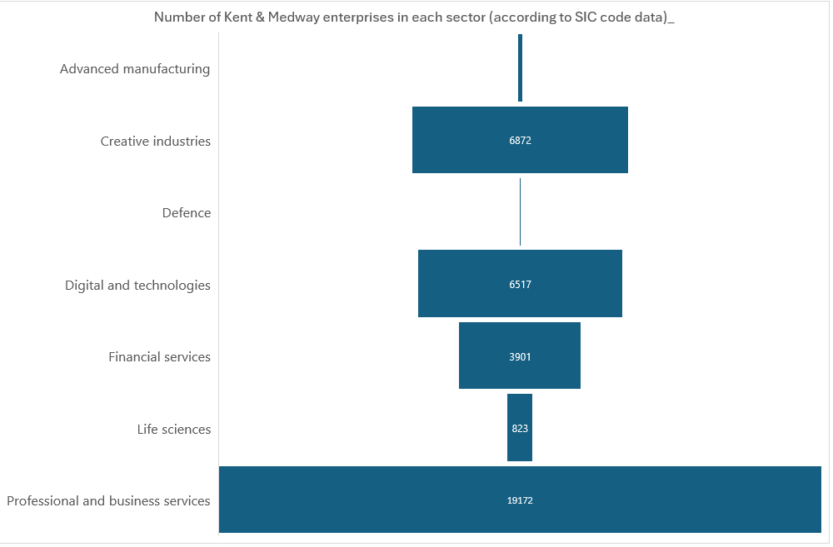
How does Kent & Medway’s business landscape align with the growth sectors?
SIC codes have not been updated since 2007, making them less effective in accurately describing modern industries.
The size of the ‘clean energy’ sector within Kent & Medway cannot be determined based on SIC codes.
To overcome this, the Government is working with Data City on the Industrial Strategy. Data City has developed Real time SIC codes (RSCIs).
Data City is a private business that uses AI to mine business data. Their AI-powered company database combines search, classification, and financial data, offering access to over 5.5 million UK companies.
Data City charges £30,000 a year for a department to have access. The Government is not making access to Data City available as part of its strategy.
170
15
Notes:
Hard to get data on this as we currently only have access to Standard Industrial Classification data - I would welcome any input from partners/ Board members who have access to datasets that can provide a more granular quantitative understanding of the landscape.

Slide 15
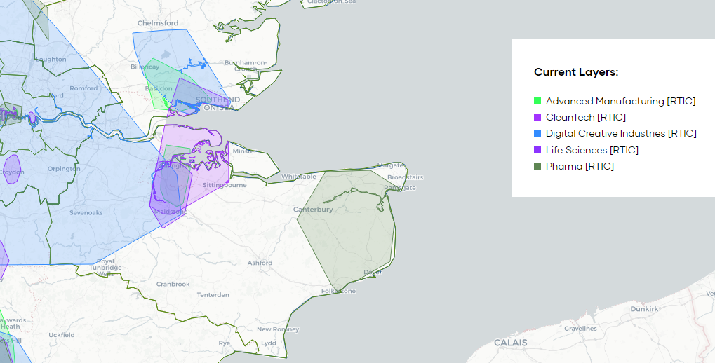
Key questions for KMEP to consider
Which Kent & Medway based clusters are high-growth?
Characterisation of clusters?
What public and private sector interventions are needed to make strategic industrial sites ‘investment-ready’?
Which clusters should the Government be aware of?
What the data and stakeholders are telling us so far….
Discovery Park and Manston are identified as strategic growth sites, with potential in clean energy production and logistics.
Cross-boundary working and collaboration with neighbouring regions can help generate the necessary scale for successful clusters.
The Innovation Clusters Map from the Department for Science, Innovation and Technology - DSIT
Notes:
The starting point is that successful clusters are characterised by strong concentrations of employment, output, high productivity and innovation. Within this, clusters can be strong in different ways: either having deep expertise in a concentrated spatial area, or encompassing related businesses and employees in broad spatial areas that cross administrative boundaries.
Clusters can take any geographical shape and often span large geographical areas, cutting across local government boundaries and nations of the UK. When defining clusters, the government will need to strike a balance between alignment with existing administrative and policy structures, and not imposing arbitrary restrictions.
This green paper seeks evidence and analysis to build on this high-level methodology. The responses will be used alongside further work and engagement with experts inside and outside of government, and within places themselves, to deepen the understanding of sectoral clusters and helpful placed-based policy interventions for growing sectors and attracting investment.

Slide 16
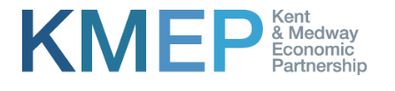
Which sectors should Kent & Medway concentrate on?
Clean Energy
Creative Industries
Advanced Manufacturing
Digital and Technologies
Life Sciences
Notes:
Hard to get data on this as we currently only have access to Standard Industrial Classification data - I would welcome any input from partners/ Board members who have access to datasets that can provide a more granular quantitative understanding of the landscape.

Slide 17
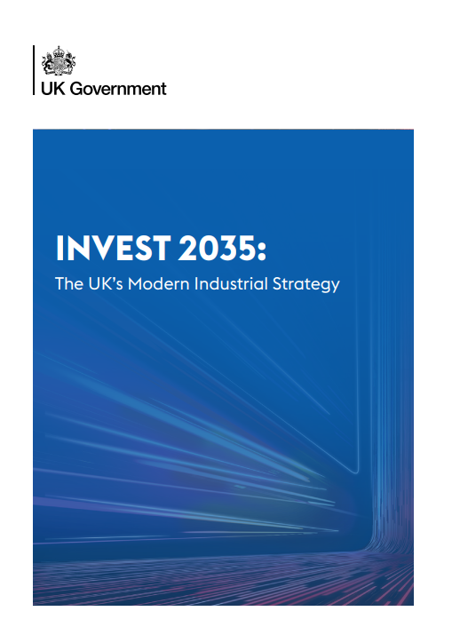
Key questions for KMEP to consider
How do we want Local Growth Plans to work?
How should the Industrial Strategy accelerate growth in city regions and clusters of growth sectors across the UK through Local Growth Plans and other policy mechanisms?
Need local representation when developing the plan.
Each functional economic area should have a Local Growth Plan – all areas are deserving of growth
Close links to economic development department – links to wider economic growth work including KMEF.
Notes:
28) How should the industrial strategy accelerate growth in city regions and clusters of growth sectors across the UK through local growth plans and other policy mechanisms?
Government has referenced engagement plans with devolved governments, elected mayors, and other local leaders, including through the Council of the Nations and Regions, and Mayoral Councils, to “galvanise regional and place-based growth opportunities, and align where appropriate”

